Slide 1


2019
Department
Of Computer
Science
&
Electrical And
Electronics
Engineering
MATH-IV
KAS -402
2020-2021
Dr.Rupa Sharma
Associate Professor
vsrsrsys@gmail.com

Slide 2
Topic-12

Slide 3
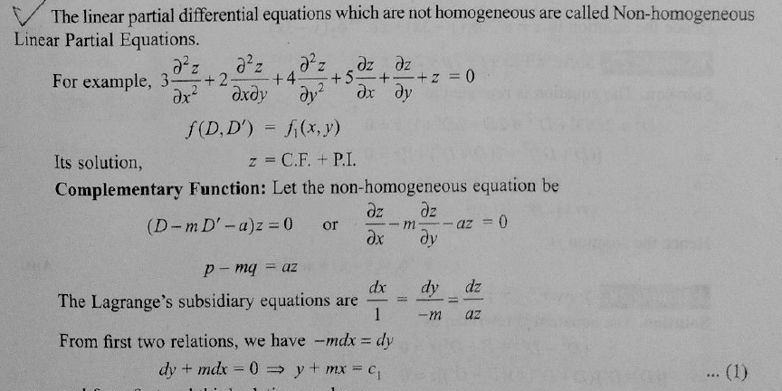

Slide 4
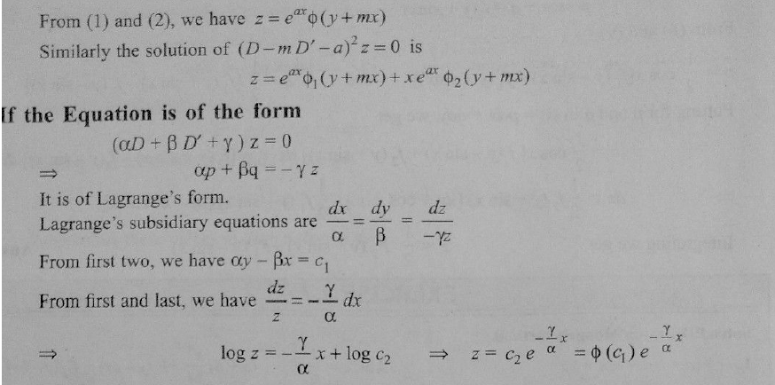


Slide 5
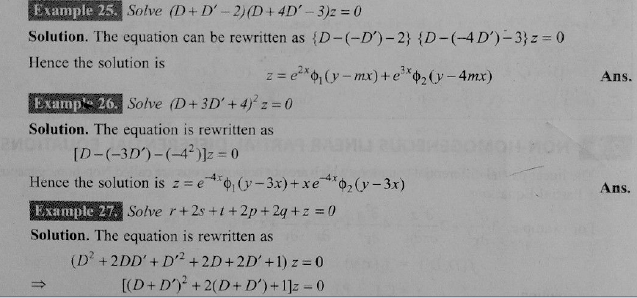

Slide 6
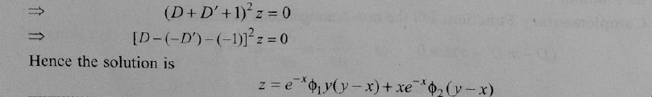

Slide 7
HOME Work

Slide 8
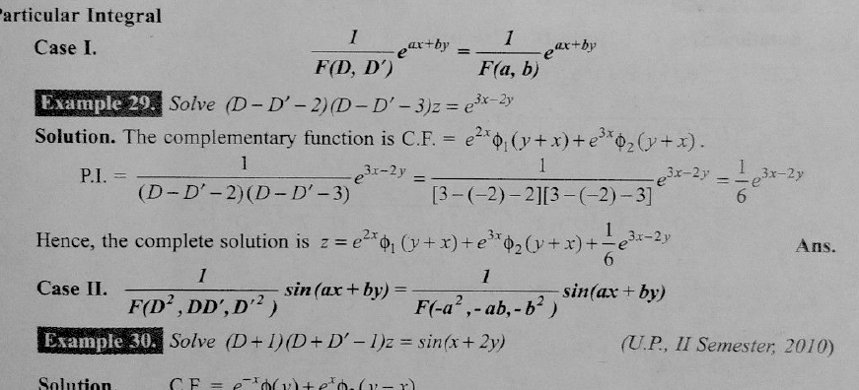

Slide 9
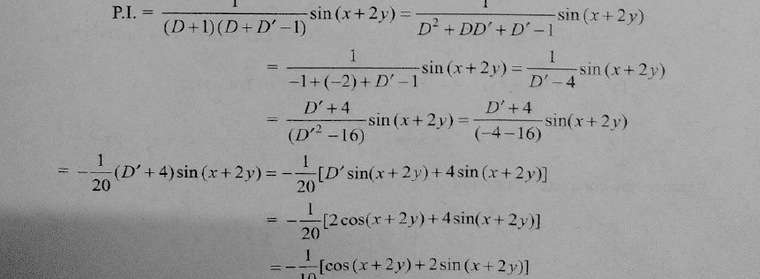

Slide 10
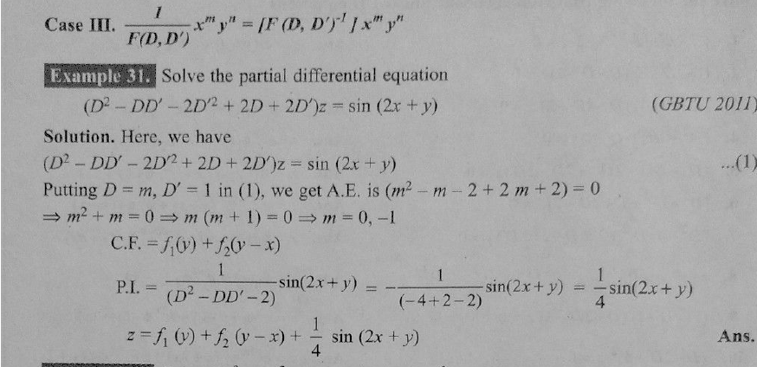

Slide 11
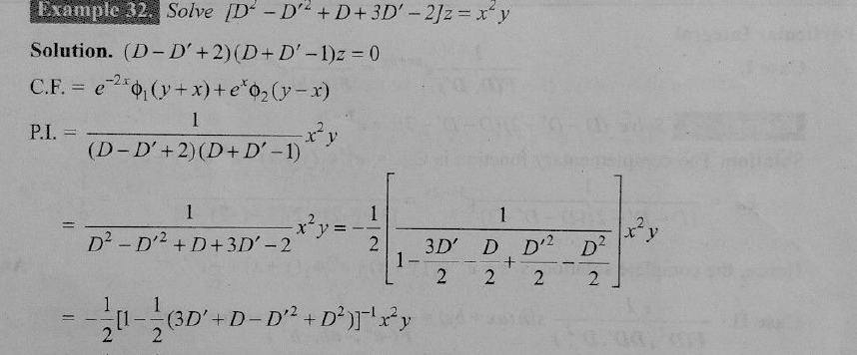

Slide 12
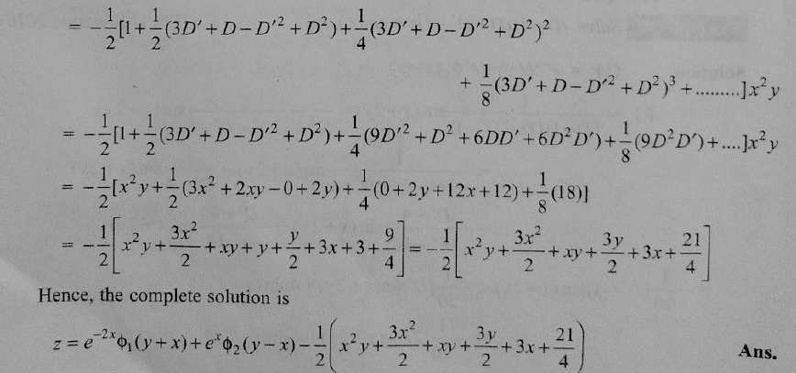

Slide 13
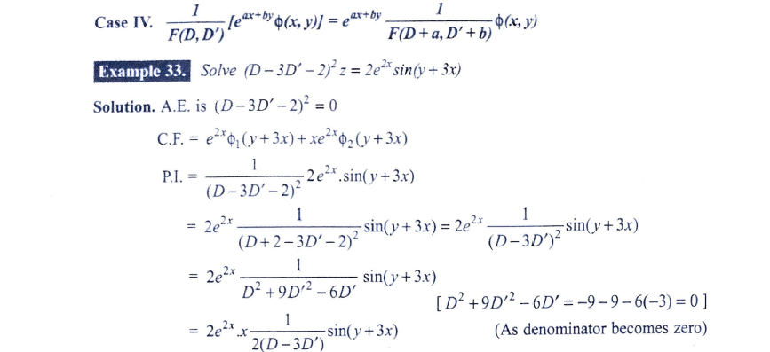

Slide 14
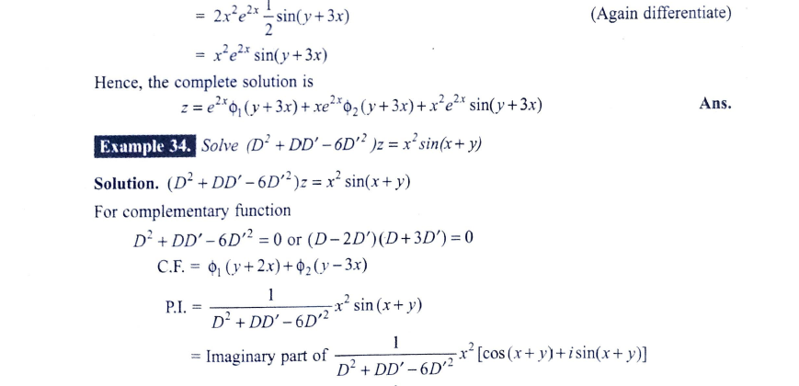

Slide 15
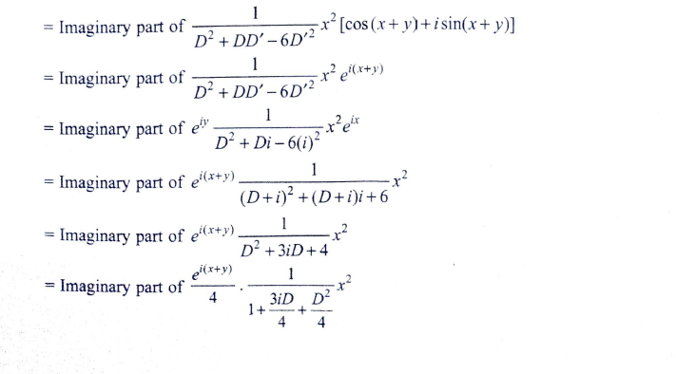

Slide 16
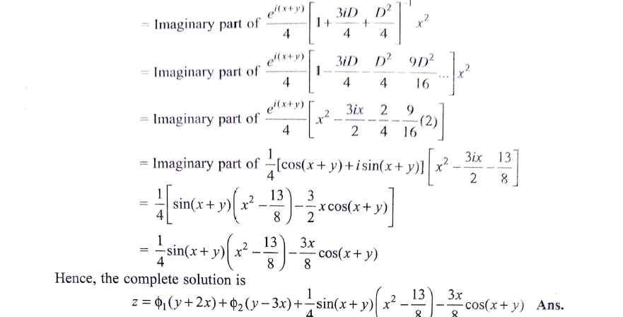

Slide 17
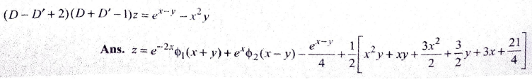
HOME Work

Slide 18
THANK YOU

